Slide 1
IBM/COURSERA Applied Data Science Capstone Project
The battle of neighborhoods: sushi restaurants in milan
RICCARDO ZANNONI

Slide 2
BUSINESS PROBLEM
Milan is probably the most international city in Italy and for few years one of the most trendy restaurant type is Sushi. For this reason the idea behind this problem is: if an investor wants to open a new Sushi restaurant, where would be the optimal location/neighborhood?
UNDERSTANDING OF THE CONTEXT

Slide 3
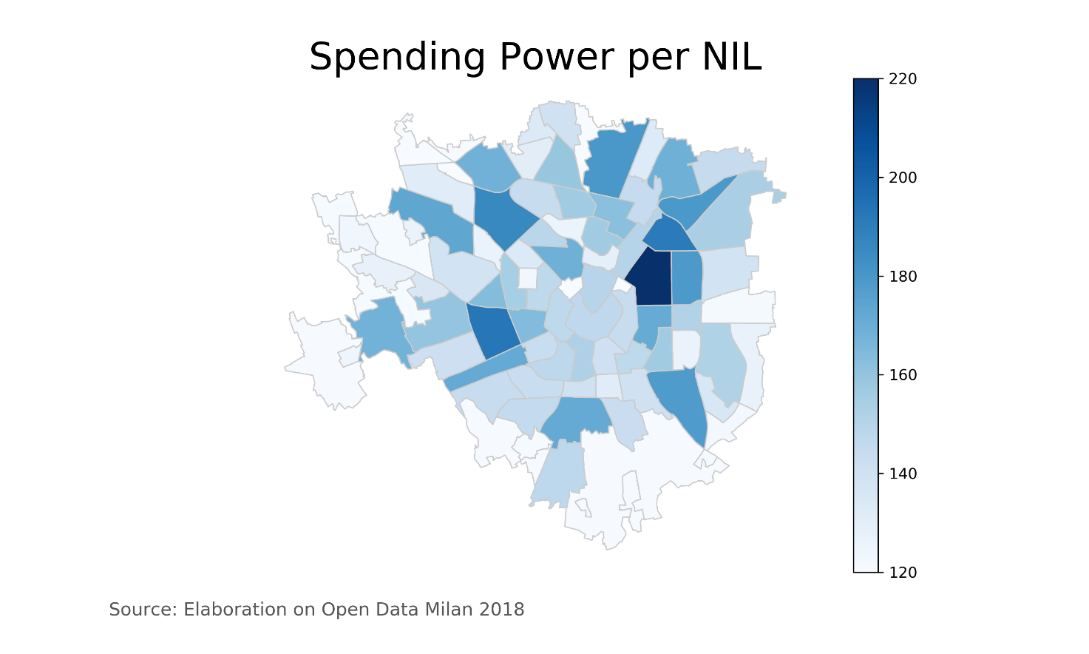
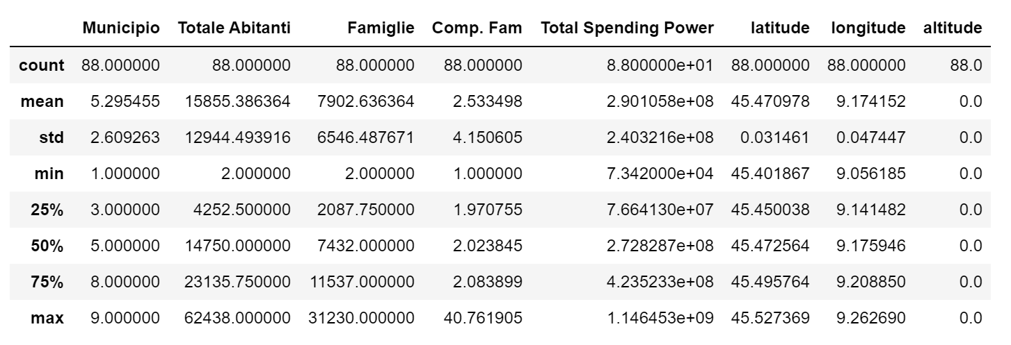
DATA

Slide 4
METHODOLOGY
Main techniques used for this analysis:
Geocoding
Venues Extraction (Foursquare API)
One Hot Encoding
Algorithm: K-means clustering

Slide 5

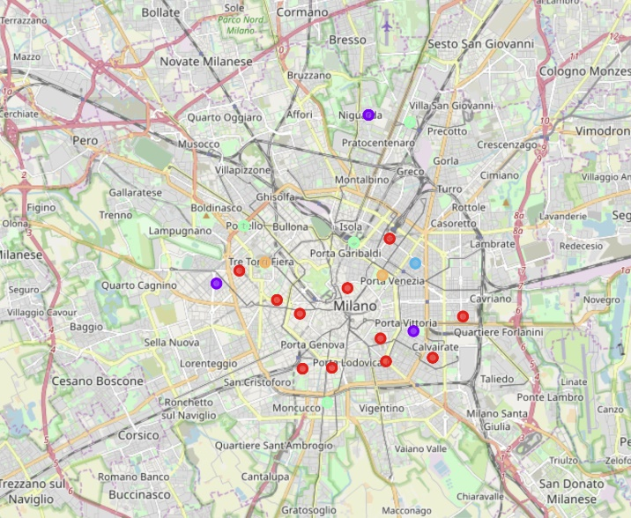
SOLUTION
For this purpose it is possible to run machine learning models (clustering) in order to make an informed decision about potential neighborhoods where to open a new sushi restaurant

Slide 6
CONCLUSION
CLUSTER | TYPE | COLOR
0 | This first cluster is characterized by Medium-Low Spending Power & Medium % of Sushi Restaurant | Red
1 | This second cluster is characterized by Medium-High Spending Power & Medium- High % of Sushi Restaurant | Purple
2 | This third cluster is characterized by High Spending Power & Low % of Sushi Restaurant. This Case is particulary interesting: due to its High Spending Power (it is the max among the 88 NIL), this Neighborhood represents itself a cluster | Blue
3 | This cluster is characterized by Low Spending Power & Medium % of Sushi Restaurant | Green
4 | This cluster is characterized by Low Spending Power & Medium-High % of Sushi Restaurant | Orange
Main techniques used for this analysis:
Thus, narrowing down the analysis, it is possible to exclude Cluster 0, 2,3,4 and we can identify Cluster 1 as the best fit

